Slide 1

CO4512: Information Security Management
Lecture 05 : IT Risk Management
Dr. Timi Enamamu

Slide 2
This lecture will cover
Risk management elements and relationships
Generic 'risk management cycle'
Different approaches for risk assessment (cont. next week)

Slide 3
Reminder: Asset, Vulnerability
Asset: anything that has value to the organization and which therefore requires protection
  The asset owner may not have property rights to the asset
  but has responsibility for its production, development,
maintenance, use and security.
Vulnerability: a weakness that might be exploited
  an incorrectly implemented or malfunctioning control,
  good control being used incorrectly.

Slide 4
Terminology: ‘Threat’
Def (Generic): A possibility that a vulnerability in your system is exploited causing harm to your organization.
Def (ENISA): Any circumstance or event with the potential to adversely impact an asset via unauthorised access, destruction, disclosure, modification of data, and/or denial of service.
A threat can be either
  Intentional (e.g., intelligent; hacker) or
  Accidental (e.g., fire; disaster)
Notes:
European Union Agency for Cybersecurity (ENISA)

Slide 5
Terminology: ‘Risk’
“A measure of the extent to which an entity is threatened by a potential circumstance or event, and typically a function of: (i) the adverse impacts that would arise if the circumstance or event occurs; and (ii) the likelihood of occurrence.”
Computer Security Resource Centre (CSRC)

Slide 6

Risk
https://pixabay.com

Slide 7
IT (Security) Risk
Risk is the product of likelihood and impact:
Risk = Likelihood * Impact
Likelihood = Threat * Attractiveness * Vulnerability
Hence:
Risk = Threat * Vulnerability * Attractiveness * Impact

Slide 8
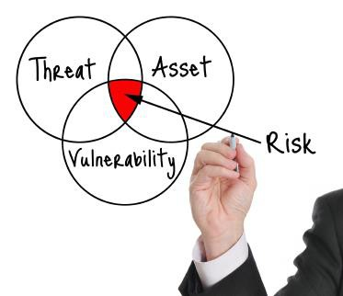
Risk according to ISO 27005
Risk associated with the potential that threats will exploit vulnerabilities of an information asset, thereby cause harm to an organization [ISO 27005]

Slide 9
Security is Risk Management
Risk management:
Risk management is the process of identifying vulnerabilities and threats to the information resources used by an organization in achieving business objectives, and deciding what countermeasures, if any, to take in reducing risk to an acceptable level, based on the value of the information resource to the organization.
- Certified Information Systems Auditor (CISA)

Slide 10
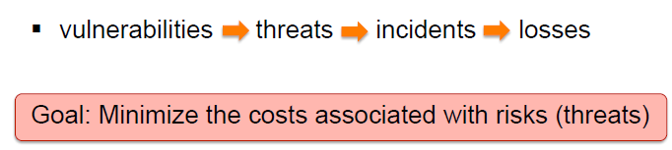
Goal of Risk Management

Slide 11
Terminology
Control: means of managing risk:
  including policies, procedures, guidelines, practices or organizational structures, which can be administrative, technical, management, or legal in nature
  'Control' is also used as a synonym for 'safeguard' or 'countermeasure'

Slide 12
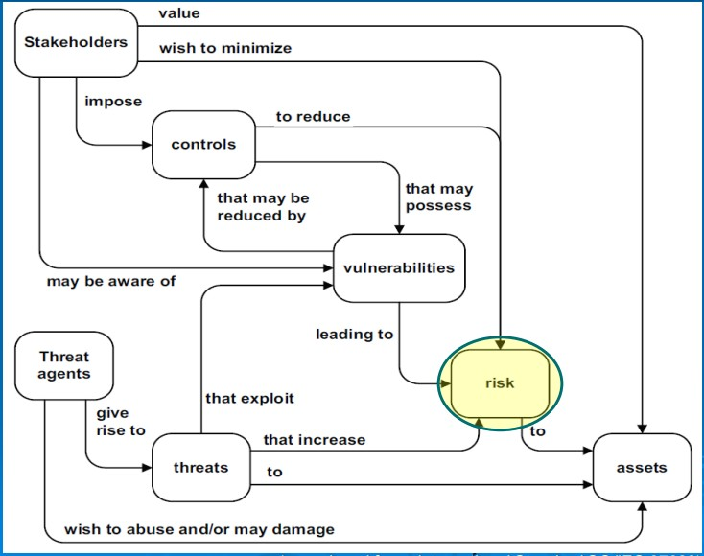

Relationships: Risk Terms
*Reproduced from ISO27032 – Security Techniques

Slide 13
Security management / risk assessment methods
– ISF METHODS FOR RISK ASSESSMENT AND RISK MANAGEMENT
–
–
ISO/IEC 27005
SP800-30 (NIST)
Our focus
AUSTRIAN IT SECURITY HANDBOOK
CRAMM
FRAP
DUTCH A&K ANALYSIS
EBIOS
IT-GRUNDSCHUTZ (IT BASELINE PROTECTION MANUAL)
MARION
MEHARI
OCTAVE V2.0 (AND OCTAVE-S V1.0 FOR SMALL & MEDIUM BUSINESSES)
Source: http://rm-inv.enisa.europa.eu/methods/

Slide 14
Relationships: Risk Management & Risk Assessment
Risk management is a continuous process that deals with the analysis, planning, implementation, control and monitoring of implemented measurements and the enforced security policy.
Risk assessment is executed at discrete time points (e.g. once a year, on demand) and, until the performance of the next assessment, provides a temporary view of assessed risks and parameterises the entire Risk Management process.
Source: http://www.enisa.europa.eu/activities/risk-management/

Slide 15
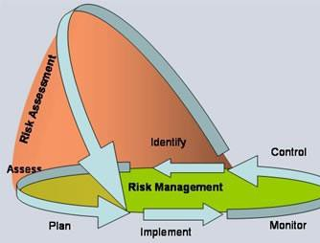
Relationships: Risk Management & Risk Assessment
Source: http://www.enisa.europa.eu/activities/risk-management/

Slide 16
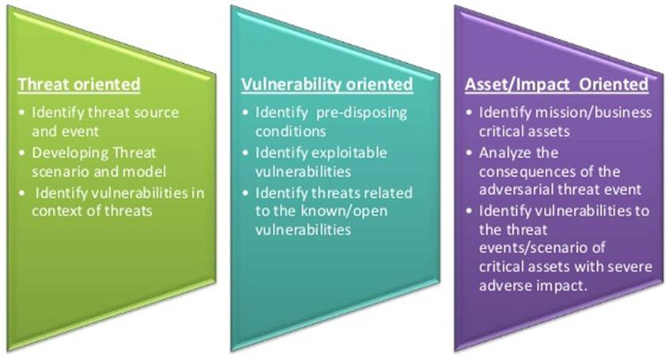
Different perspectives for risk assessment
c.f. https://www.bmc.com/blogs/risk-assessment-vs-vulnerability-assessment/

Slide 17
Different perspectives: Risk Assessment (RA)
Asset-oriented' RA: identification and valuation/ classification of assets is the starting point
identification of threats and vulnerabilities affecting those assets (or most valuable assets) drives the risk assessment (e.g. ISO 27005)
‘Threat-oriented' RA: identification of threats/ threat sources (e.g., via threat modelling or threat scenarios) is the starting point
vulnerabilities are identified in the context of the threats (e.g. NIST 800-30)
‘Vulnerability-oriented’ RA: identification/ assessment of vulnerabilities is the starting point
- identification of threats is driven by these vulnerabilities (e.g. NSFOCUS Tool)

Slide 18
CO4512 Focus
ISO/IEC 27005 (ver. 2011)
  Asset oriented risk assessment
SP 800-30 (SP 800-30 Rev. 1)
  Threat oriented risk assessment

Slide 19
Continuous Improvement
‘Continuous Improvement’ requires the following:
  Facilitatation via measurement and metrics
  (through an annual cycle using controls for integrity of data)
  Risk Assessments
  Training / Keeping everyone up-to-date
  Use of tools e.g., Plan-Do-Check-Act (Deming Cycle) for
reviewing your improvement (1)

Slide 20
Wider Reading
ISO/IEC 27004 (2016)
Guidance on development and use of measures and measurements for the assessment of the effectiveness of the ISMS controls
Use of metrics to monitor effectiveness and performance of employed methods/ techniques
Note: these are usually organisation-specific: what works for one organization does not mean benefits for another

Slide 21
First:
‘Threat-oriented’ Risk Assessment
NIST SP 800-30 Rev. 1

Slide 22
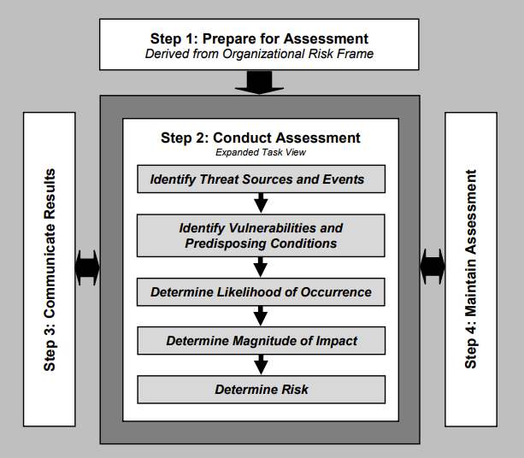
NIST SP 800-30
Risk Assessment Phase
Risk Mitigation
Source: https://nvlpubs.nist.gov/nistpubs/

Slide 23
NIST SP 800-30
Risk Assessment is comprised of nine steps:
Step 1: System Characterization
Step 2: Threat Identification
Step 3: Vulnerability Identification
Step 4: Current Control Analysis
Step 5: Likelihood Determination
Step 6: Impact Analysis
Step 7: Risk Determination
Step 8: Control Recommendations
Step 9: Results Documentation

Slide 24
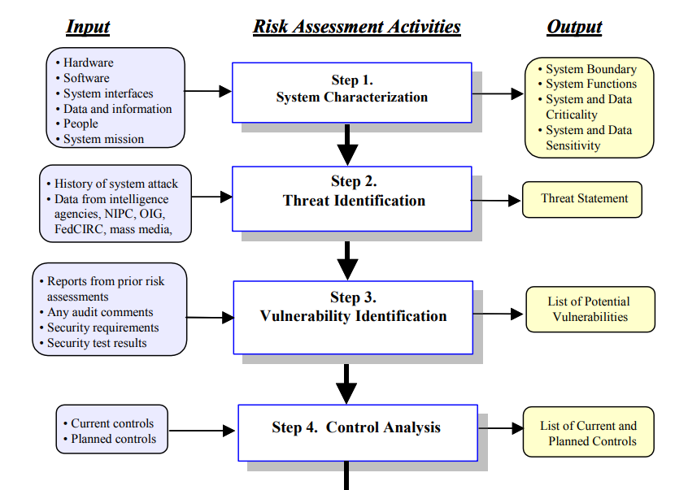
Steps 1-4: Identifying System Weaknesses
Source: https://www.ucop.edu/information-technology-services/

Slide 25
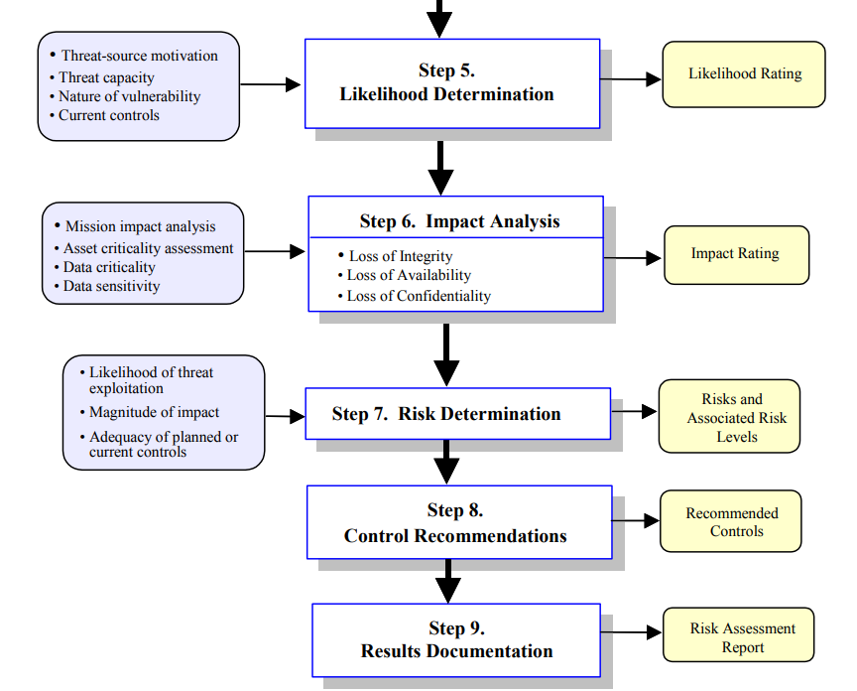
Steps 5-9: Risk Determination Phase
Source: https://www.ucop.edu/information-technology-services/

Slide 26
References
ISO 27005: http://www.iso27001security.com/html/27005.html
SP 800-30 r.1: https://nvlpubs.nist.gov/nistpubs/
Inventory of methods: http://rminv.enisa.europa.eu/methods/
NIST Risk Management Guide: https://www.ucop.edu/
(1) Deming Cycle: https://www.process.st/deming-cycle/

Slide 27

Any questions?

Slide 28

What next?
In the next lecture we will cover the ISO 27005 approach

